Slide 1
^{history.ac.uk/library}
Institute of
Historical Research
Wohl Library
IHR library services and collections
^{history.ac.uk/library}

Slide 2
Institute of Historical Research
The Institute of Historical Research is the UK's national centre for history, dedicated to supporting historians
One of nine institutes that comprise the University of London's School of Advanced Study
Library, events, fellowships, training, publications and resources
The IHR is a leading centre for the creation of digital resources for historians, and promotes the study of people and locality through our Centre for the History of People, Place and Community.
Find out more history.ac.uk
^{history.ac.uk}
Notes:
General IHR intro (where needed)

Slide 3
^{IHR library}
Collections:
Primary sources, guides and methodology
Early medieval to contemporary history
Western Europe, Americas and World history
Search catalogue via website
Free membership, join online
Contact us or book a help session if you’d like further advice
Find out more: email ihr.library@sas.ac.uk or online at:
^{history.ac.uk/library}
Notes:
Quick one-slide intro (to be used separately from rest)

Slide 4
^{Collections}
Around 200,000 primary sources, guides, reference works and periodicals
Collections strengths: Britain, Western Europe, the Americas, local and regional history
From early medieval to contemporary
Print, electronic, microform collections
We work collaboratively with other libraries including Senate House Library, Institute of Advanced Legal Studies, Institute of Classical Studies and Warburg Institute
^{history.ac.uk/library}

Slide 5
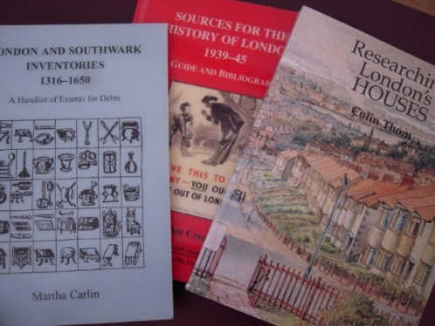
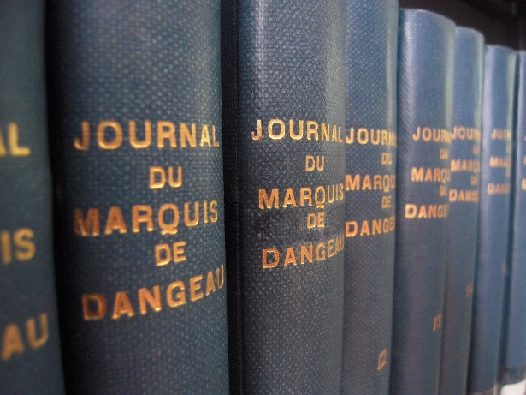
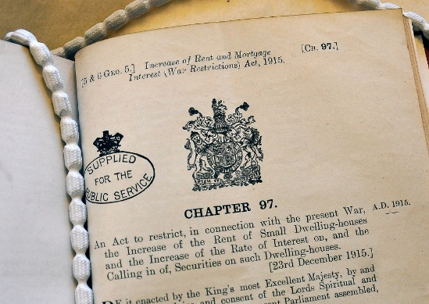
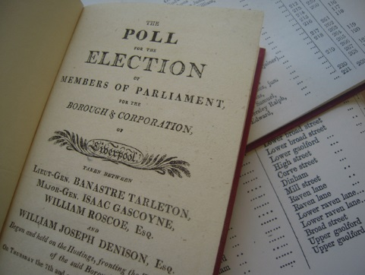
^{Collections}
Guides and methods
Letters and diaries
Parliamentary sources
National and local records
^{history.ac.uk/library}

Slide 6
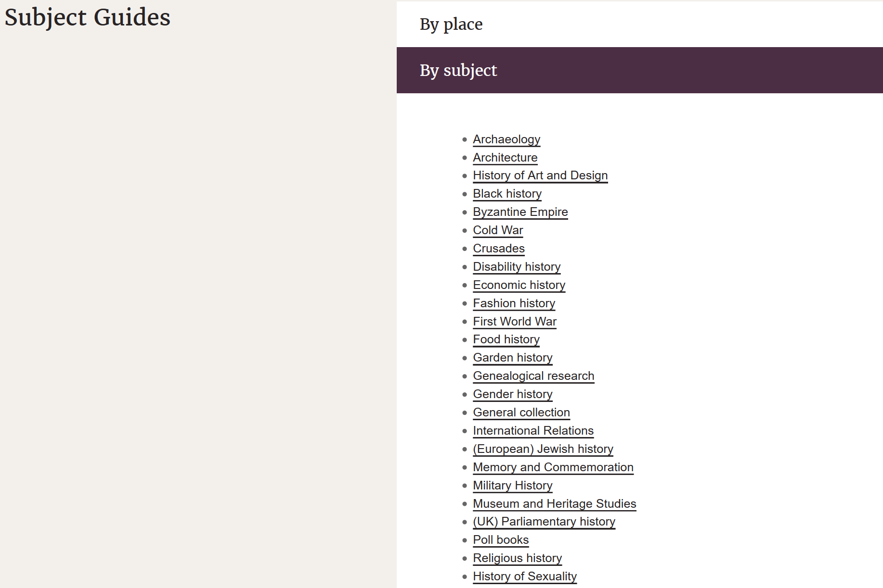
^{Collection guides}
Browse our collection guides which are arranged by place, subject and format.
history.ac.uk/library/collections

Slide 7
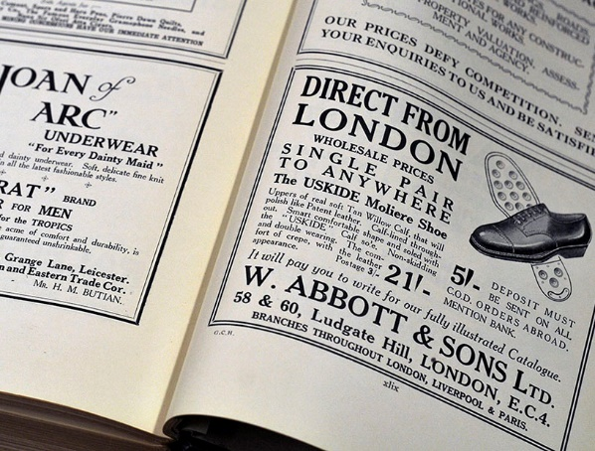
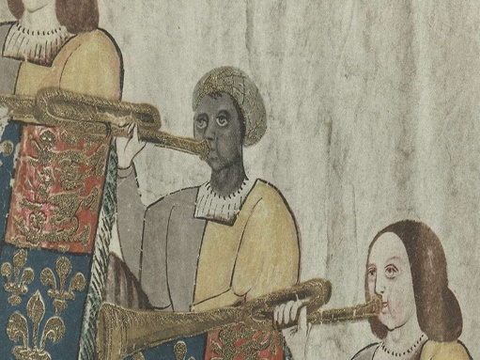
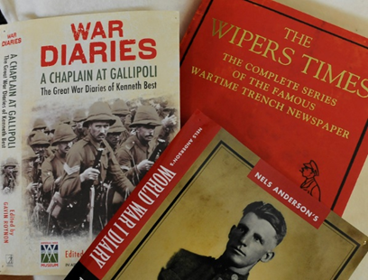
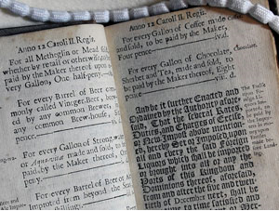
^{Collection guides}
Fashion history
Black history
First World War
British history
history.ac.uk/library/collections

Slide 8
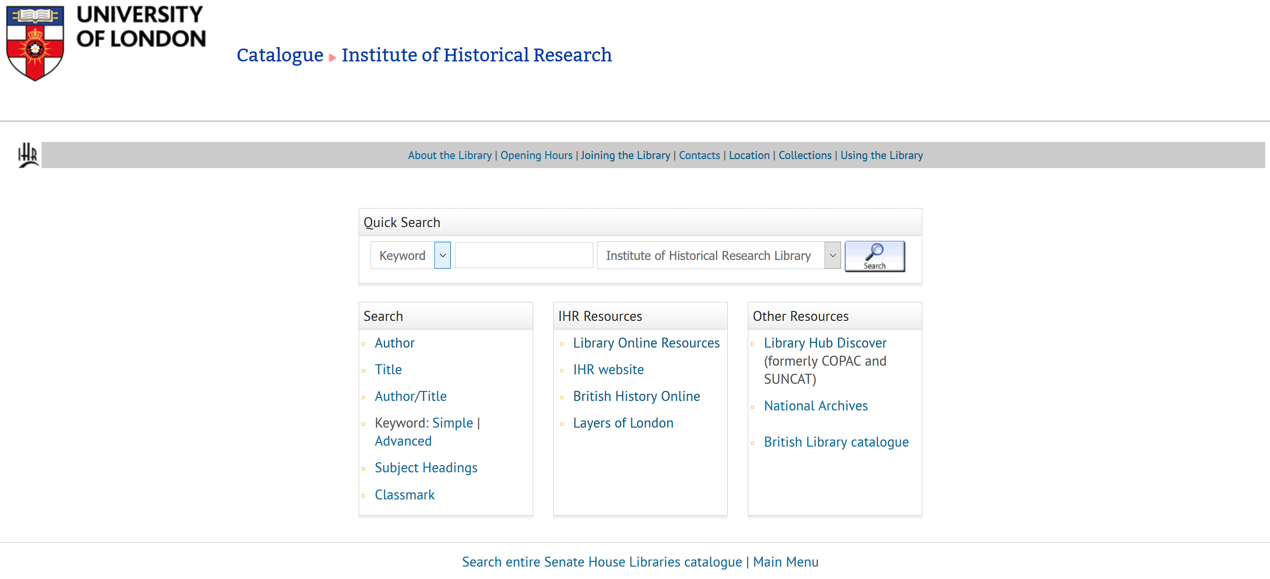
^{Library catalogue}
catalogue.libraries.london.ac.uk/search~S10

Slide 9
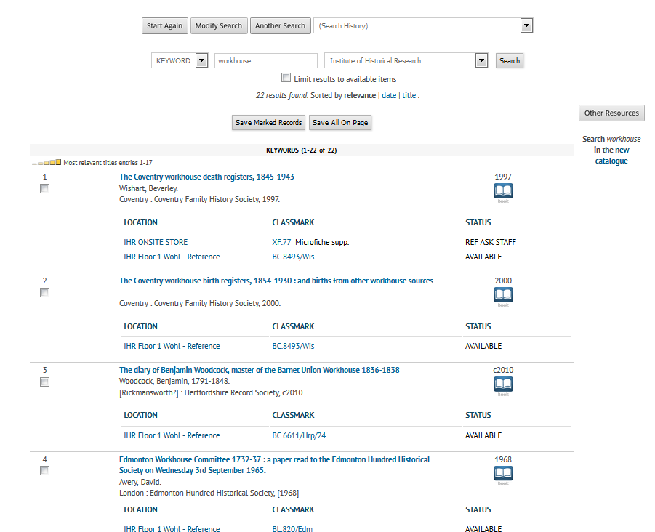
^{Library catalogue}
catalogue.libraries.london.ac.uk

Slide 10
^{Collection locations}
Floor 1: Britain and Ireland, Religious History, Byzantine Empire and the Crusades
Floor 2: Historiography and Methodology, France, Germany, Italy, Low Countries, Portugal, Spain, Jewish history, North America, Latin American and Mexican history
Ground floor: Common room and current periodicals
Lower ground floor: Military/International relations, the History of Universities
Onsite store and offsite store: items can be requested in advance
Collections are all for library use only
^{history.ac.uk/library}
Notes:
Skip this?

Slide 11
^{Closed access: need to request}
Onsite store
Periodicals
African, Asian and Australasian History
Austrian, Swiss, Scandinavian History
Latin America, US Congressional Records and US State History
Theses
Offsite store
General Bibliographic Works
European Parliamentary Papers
The Canada and Dublin Gazette
East European History
^{history.ac.uk/library}

Slide 12
^{Online resources}
Most are available in library reading rooms only due to licence restrictions
Links to free online resources
Historic databases, digitised sources, parliamentary sources, newspapers, guides to sources
Ask if you need any help
history.ac.uk/library/collections/online-resources

Slide 13
^{Online resources (SAS users)}
Can be accessed offsite with your student card
Links to free online resources
Historic databases, digitised sources, parliamentary sources, newspapers, guides to sources.
Historic Digimap
Ask if you need any help
history.ac.uk/library/collections/online-resources
Notes:
For SAS users

Slide 14
^{Curated list of resources}
history.ac.uk/librarycollections/online-resources/open-access-resources

Slide 15
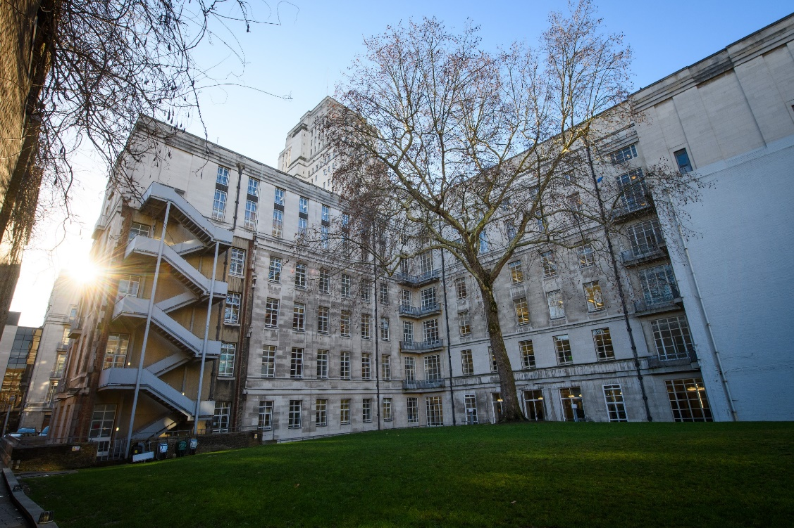
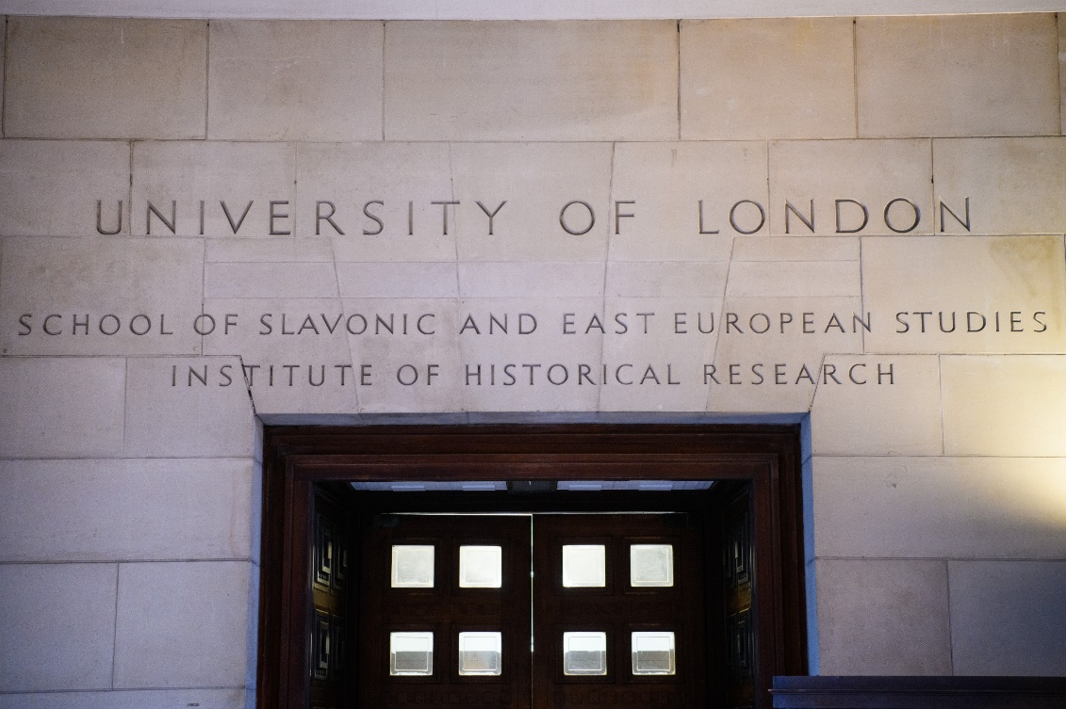
^{Location}
Senate House North Block
Malet street or Russell square
^{history.ac.uk/library}

Slide 16
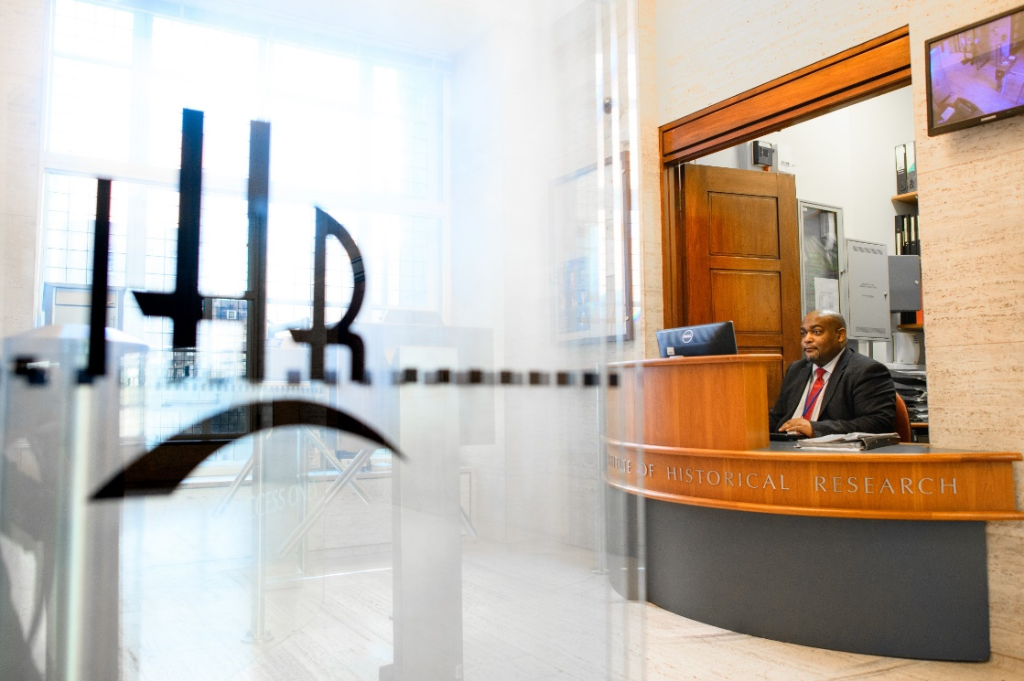
^{Membership}
Free
Join online. We can either post your card or you can collect
School of Advanced Study users can use your SAS ID card
history.ac.uk/library/library-membership

Slide 17
^{Access during COVID-19}
You will need to book places in advance
Social distancing set-up and guidelines in place for your safety
It is recommended to book collections in advance as items used will need to be quarantined
We recommend bringing your own computer and camera for copying
We can offer a scanning and document supply service
Keep an eye on our website for any short-notice changes as the situation evolves
history.ac.uk/ihr-library-reader-access-update

Slide 18
^{Temporary opening hours}
11:00 – 15:00 Monday to Wednesday by appointment only
Subject to change at short notice: for latest information see website
Email enquiry service on other weekdays
history.ac.uk/ihr-library-reader-access-update

Slide 19
^{Contacts and training}
ihr.library@sas.ac.uk
Library enquiry office and phone 020 7862 8760 during library opening hours but email best at the moment
We can help with locating collections and using online resources
Ask to book a help session, these will be held online where possible
history.ac.uk/library/using/tour

Slide 20
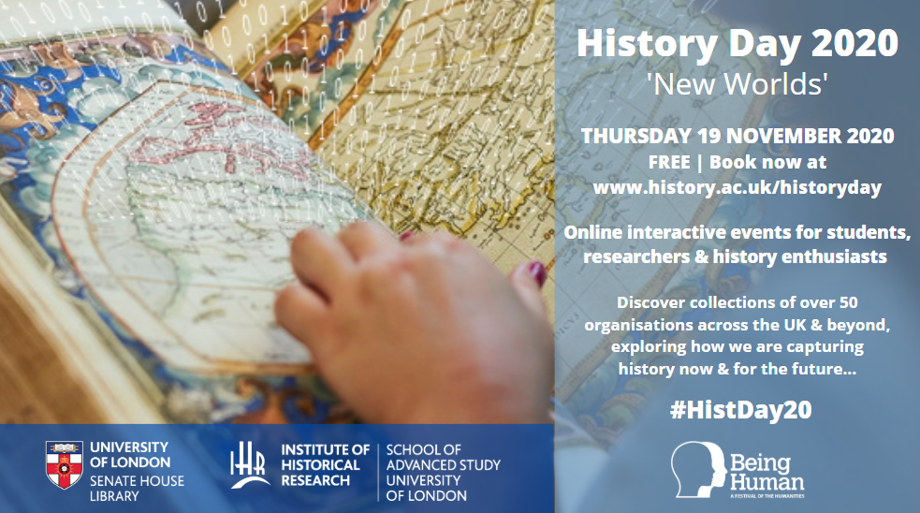
History Day 2020: Thursday 19 November - Online
Sign up! https://www.history.ac.uk/events/history-day-2020
#HistDay20
history.ac.uk/events/history-day-2020
Notes:
History day is our annual event celebrating and helping you to discover more about History collections. This year it will be online on Thursday 19 November. There are a range of diverse sessions including collection and resource tours, a live-streamed walking tour, Q&As and panel discussions on archiving 2020, local history and digital history.

